Slide 1
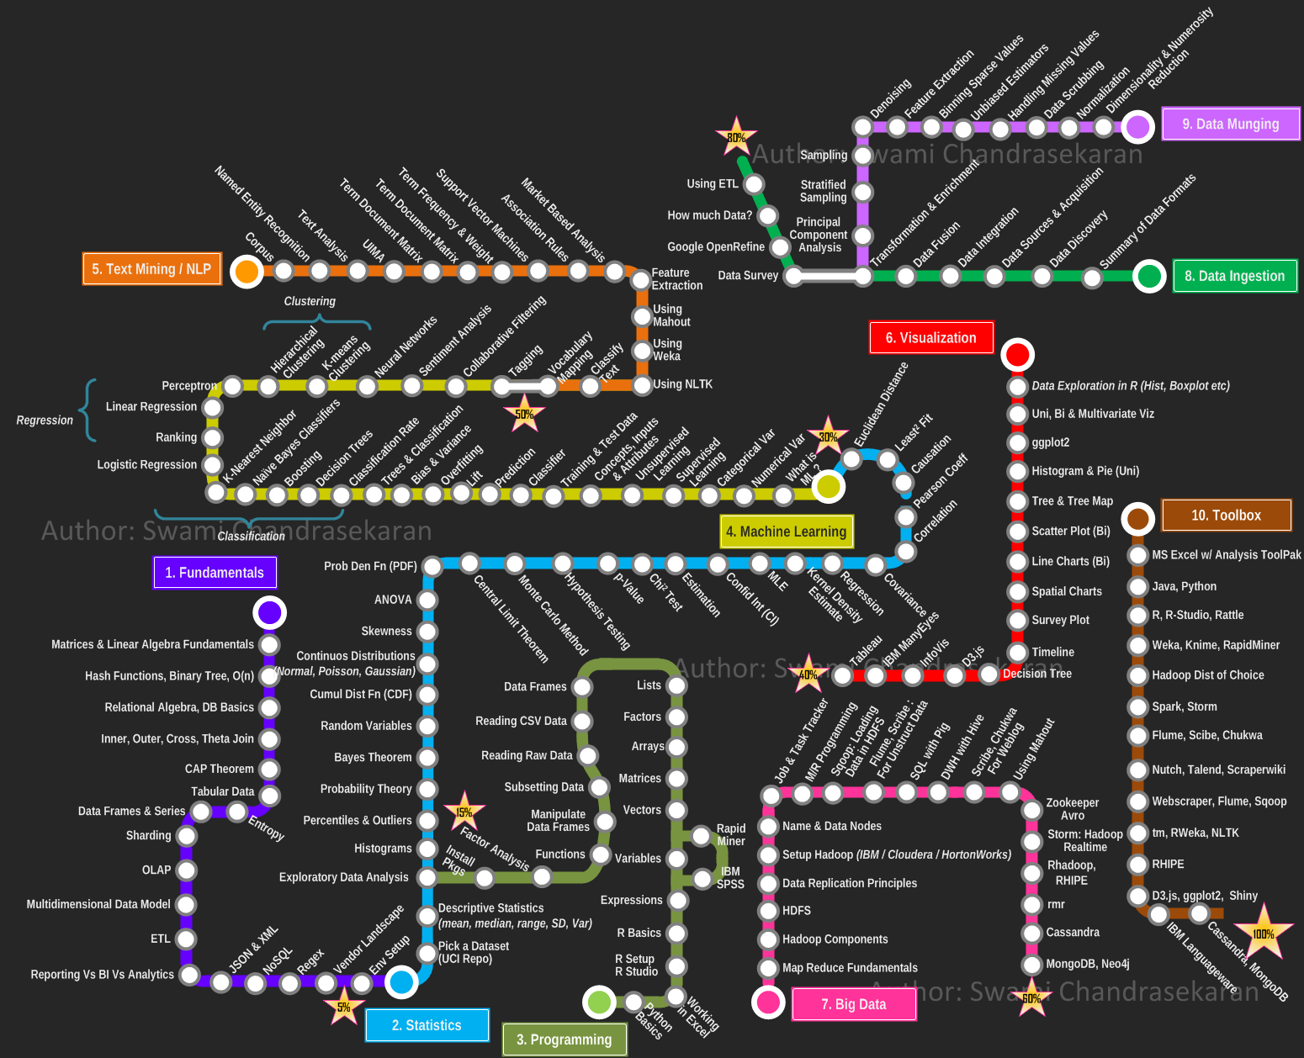
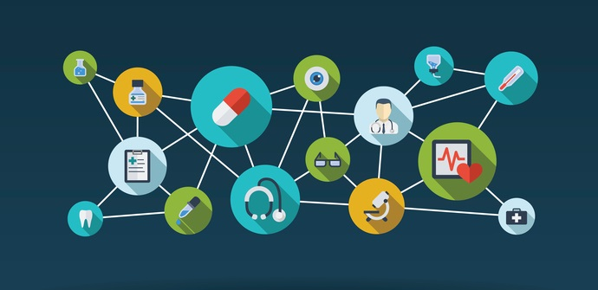
DATA SCIENCE IN HEALTHCARE & LIFE SCIENCES
APPLIED CLINICAL ANALYTICS

Slide 2




DATA ANALYTICS IN HEALTHCARE & LIFE SCIENCES
Descriptive
Predictive
Prescriptive
BUSINESS PROBLEMS
DATA SOURCES
ACTIONABLE INSIGHTS
ANALYTICS ALGORITHMS
VITAL BUSINESS PROBLEMS: So many different problems exist and they are of varying degree of complexity: - What impacts favorable clinical outcomes - Drivers of adverse events - Factors impacting cost of care - Earlier diagnosis of cancers and chronic diseases Understanding these different business problems is critical for generating possible solutions
POTENTIAL DATA SOURCES: Huge amounts of data is getting generated nowadays from different sources that are capable of capturing information : - Electronic Health Records - Healthcare claims from Insurance companies - Pharmacies – claims and medication reviews - Lab tests and Imaging results - Population health data – Social Determinants of Health - Genomics (and later Proteomics and Metabolomics) - Wearable and other devices - Other sources (Surveys, Patient Reported Outcomes) The volume, velocity, variety, and veracity that is getting generated is staggering – typical Big Data problem.
DATA PROCESSING, MANAGEMENT AND ANALYSIS: Making sense of these varied sources of data and processing them so that they are useful for analysis is a data engineering challenge. Structured data needs to be cleaned and curated; data from different sources need to be matched to get a complete 360 degree view of the customer. Semi-structured and unstructured data sources (Physician notes, imaging data) pose challenges to curate and store the information so that it can be retrieved and analyzed at scale and speed. Various Big Data technologies have been developed to tackle this problem of storing(HADOOP ecosystem, SPARK) and analyzing semi-structured and unstructured data (Text mining, NLP, Deep Learning for Image and Video Analytics).
SOLUTIONS TO THE PROBLEMS: At the end of the day, all the analysis should be able to generate actionable insights. Interpretation of the results and their implementation to solve the problem are key.

Slide 3
HOW ML/DL CAN AUGMENT THE DECISION MAKING PROCESS FOR CLINICIANS
PROGNOSIS
A machine-learning model can learn the patterns of health trajectories of vast numbers of patients. This facility can help physicians to anticipate future events at an expert level, drawing from information well beyond the individual physician’s practice experience. For example, how likely is it that a patient will be able to return to work, or how quickly will the disease progress?
DIAGNOSIS
A diagnostic error will occur in the care of nearly every patient in his or her lifetime, and receiving the right diagnosis is critical to receiving appropriate care. This problem is not limited to rare conditions. Cardiac chest pain, TB, dysentery, and complications of childbirth are commonly not detected even in developing countries
TREATMENT
In a large health care system with tens of thousands of physicians treating tens of millions of patients, there is variation in when and why patients present for care and how patients with similar conditions are treated. Can a model sort through these natural variations to help physicians identify when the collective experience points to a preferred treatment pathway?
REMOTE AREAS
CLINICAL WORKFLOW
The same machine-learning techniques that are used in many consumer products can be used to make clinicians more efficient. Machine learning that drives search engines can help expose reqd. .information in a patient’s chart for a clinician without multiple clicks. Data entry of forms and text fields can be improved with the use of machine-learning techniques.
There is no way for physicians to individually interact with all the patients who may need care. Can machine learning extend the reach of clinicians to provide expert-level medical assessment without involvement? For example, patients with new rashes may be able to obtain a diagnosis by sending a picture that they take on their smartphones, thereby averting unnecessary urgent-care visits.
REFERENCE: https://www.nejm.org/doi/full/10.1056/NEJMra1814259

Slide 4







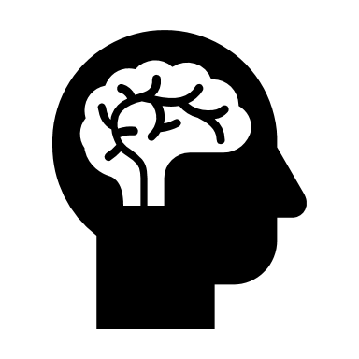



COMPONENTS OF ELECTRONIC HEALTH RECORDS
EMR
DEMOG &
HISTORY
DRUGS
ALLERGIES
VISITS
PROCEDURE
ADMISSIONS
DIAGNOSES
LAB RESULTS
STANDARD EMR/EHR DATA COMPONENTS
DEMOGRAHICS – Age, Gender, Race, Language, Religion, Insurance, Location
CLINICAL HISTORY – Habits, Past Dx and Observations
MEDICATIONS – Drug NDC, Quantity, Refills, Route, Rx dates
FOOD AND DRUG ALLERGIES – Allergen, Reaction Desc., Severity, Dates
VISITS TO ER AND OPD – Date/Time, Encounter Type, Provider Info
INPATIENT ADMISSIONS – Date/Time, Source, Discharge Code
PRIMARY DIAGNOSES AND COMORBIDITIES – ICD9/10, SNOMED
PROCEDURES AND SURGERIES – Procedure codes and ICD codes
LABORATORY RESULTS – LOINC, Date/Time, Reference Range, Value, UOM
Standard dictionaries: ICD9/10, SNOMED-CT, NDC, LOINC, NPI
ADDITIONAL DATA FACTORS (normally not present)
GENOMICS
SOCIAL DETERMINANTS OF HEALTH
IMAGING DATA – X-RAY/USG/CT/MRI
PATIENT REPORTED OUTCOMES - PRO
GENOMICS
IMAGING
SDoH
OUTCOMES

Slide 5
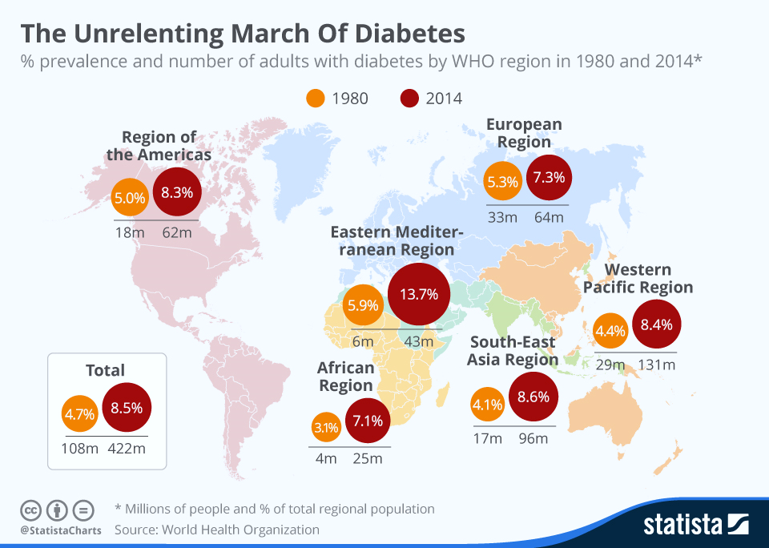
DIABETES – THE MAGNITUDE OF THE PROBLEM
Diabetes is the world's eighth biggest killer, accounting for some 1.5 million deaths each year. A major new World Health Organization report has now revealed that the number of cases around the world has nearly quadrupled to 422 million in 2014 from 108 million in 1980. The Eastern-Mediterranean region had the biggest increase in cases during that time frame. Diabetes now affects one in 11 adults with high blood sugar levels linked to 3.8 million deaths every year.
REFERENCE: https://www.statista.com/chart/4617/the-unrelenting-global-march-of-diabetes/

Slide 6
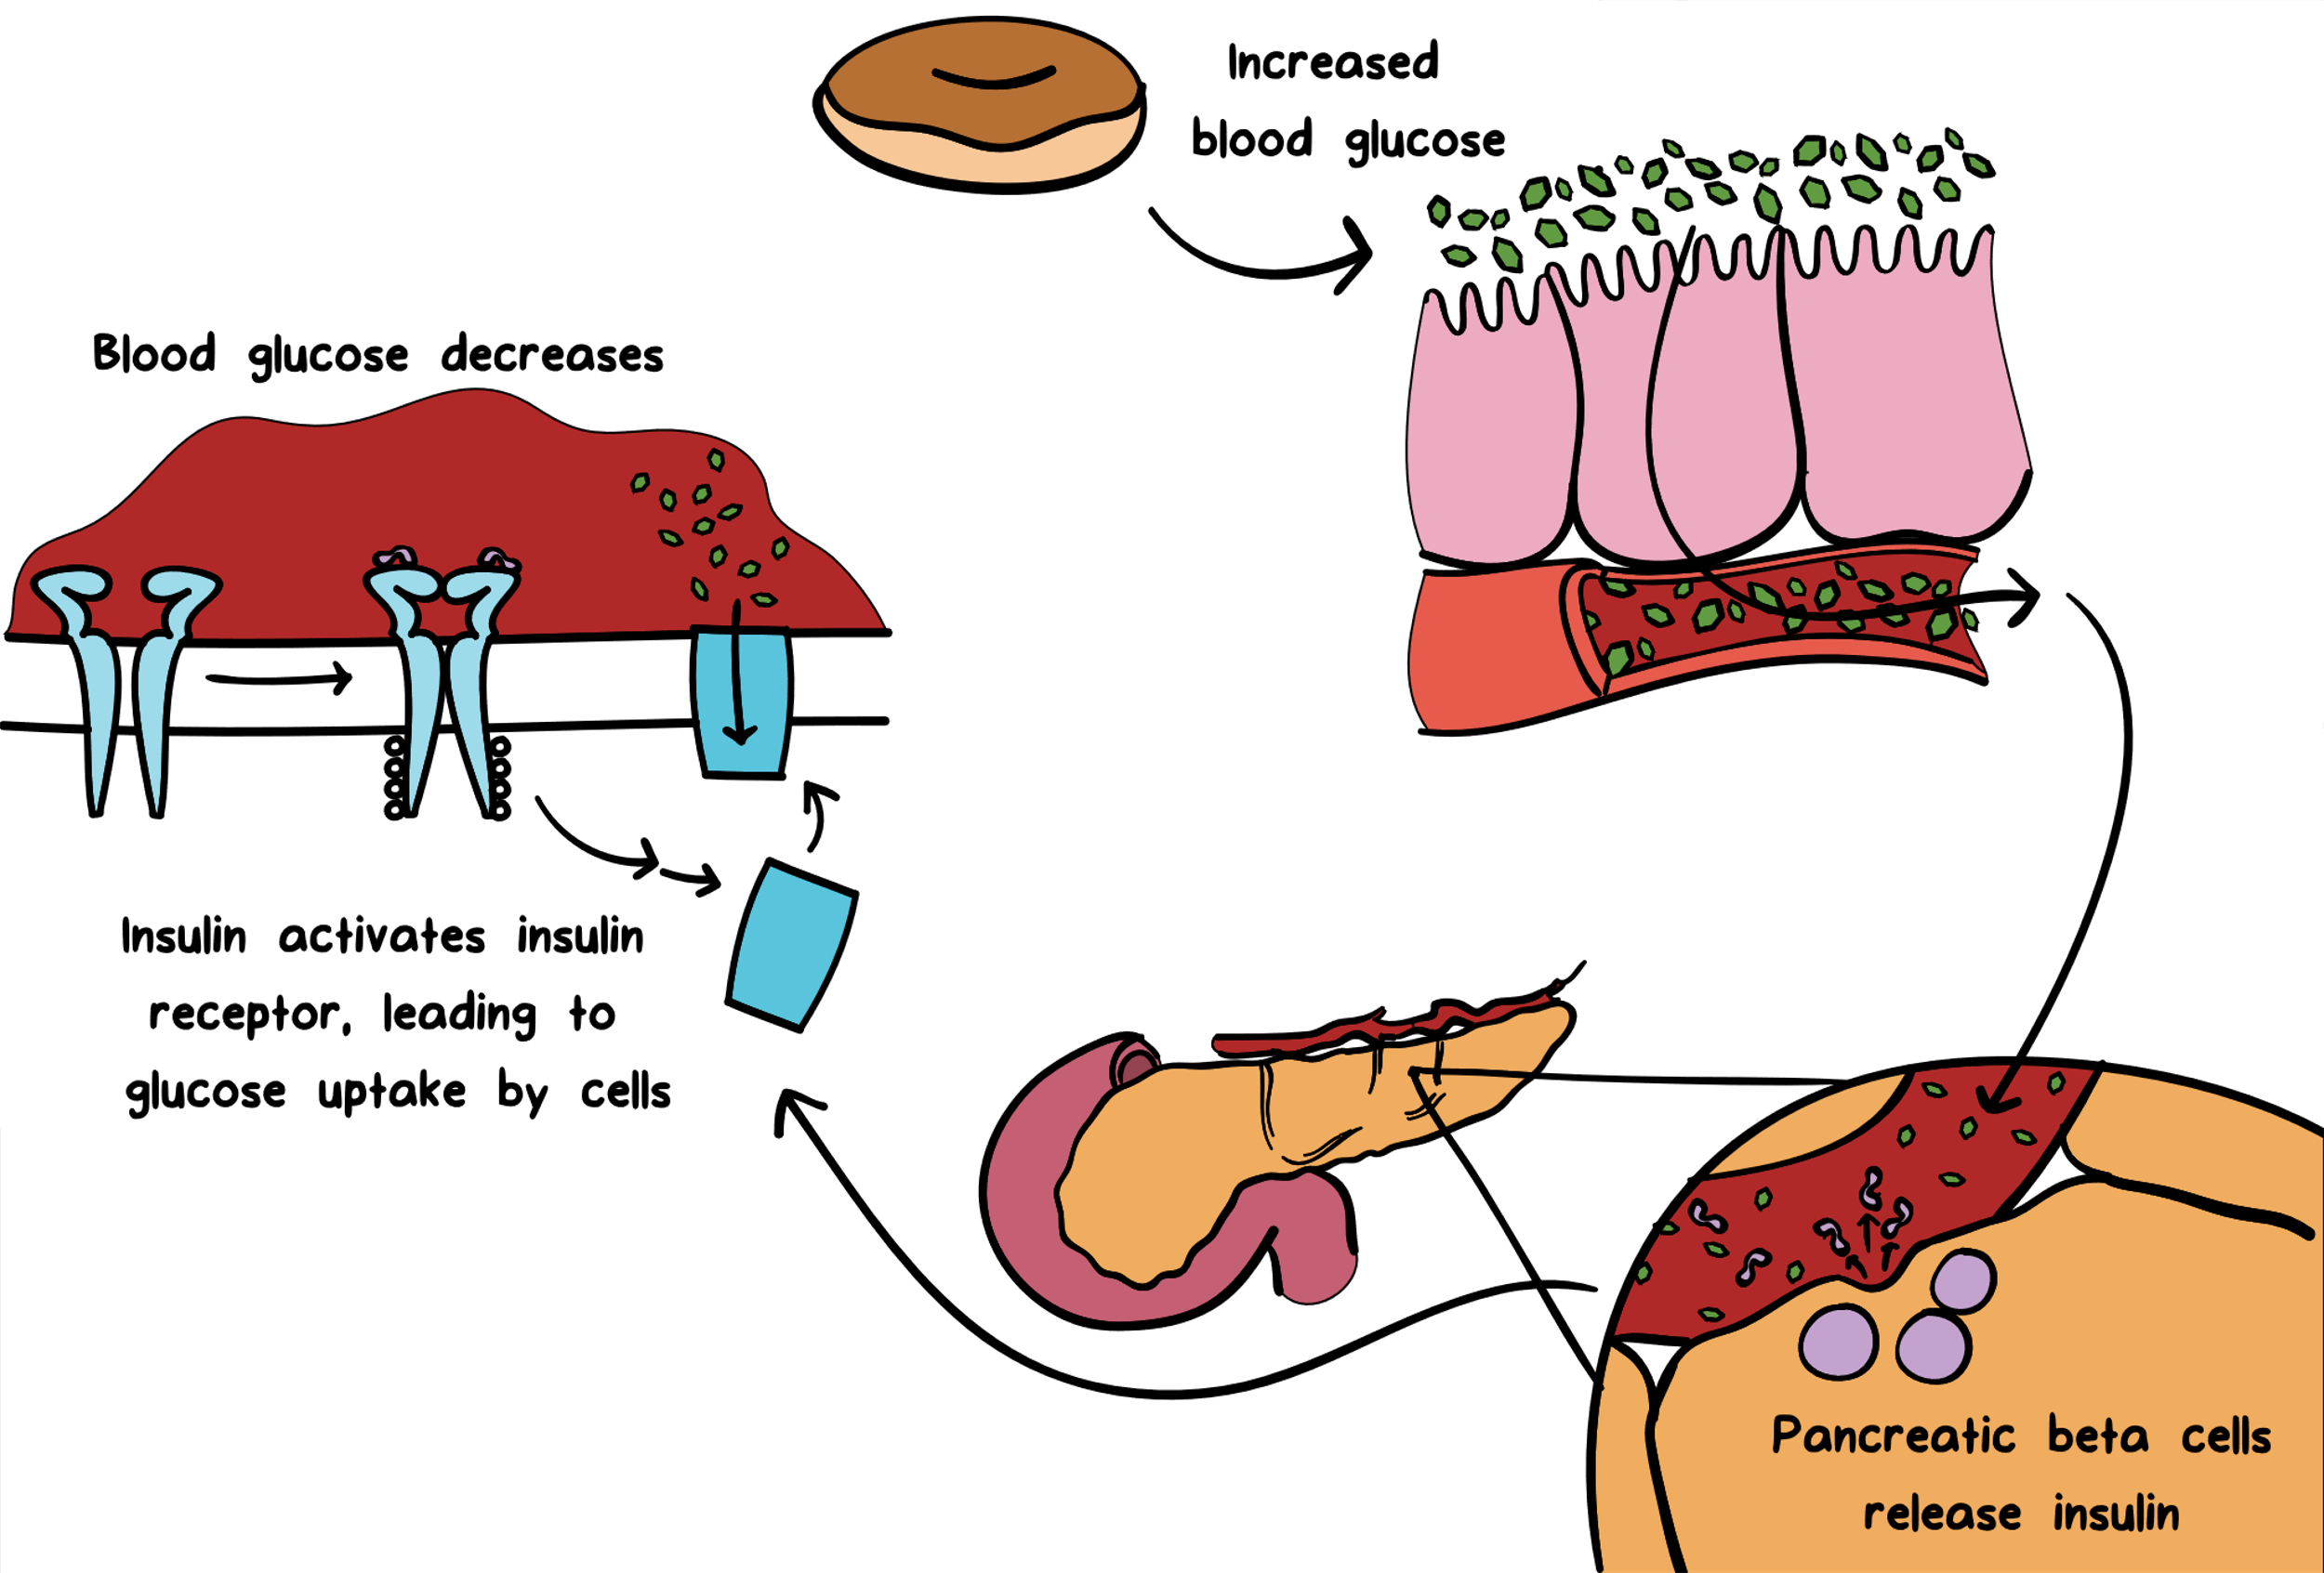
WHAT HAPPENS IN DIABETES MELLITUS
https://youtu.be/qn2dhw0NJxo
Type 1 diabetes (T2DM)
In people with type 1 diabetes, the body does not make insulin. The immune system attacks and destroys the cells in the pancreas that make insulin. Type 1 diabetes is usually diagnosed in children and young adults, although it can appear at any age. People with type 1 diabetes need to take insulin every day to stay alive.
Type 2 diabetes (T1DM)
In people having type 2 diabetes, the body does not make or use insulin well. It can develop diabetes at any age, even during childhood. However, this type of diabetes occurs most often in middle-aged and older people. Type 2 is the most common type of diabetes.
COURTESY: NIDDK https://www.niddk.nih.gov/health-information/diabetes/overview/what-is-diabetes
IMAGE COURTESY: KHAN ACADEMY

Slide 7
HOW MACHINE LEARNING CAN HELP IN DIABETES
Use of a Machine Learning Algorithm Improves Prediction of Progression to Diabetes
Predicting Future Glucose Fluctuations Using Machine Learning and Wearable Sensor Data
Predicting Diabetes Mellitus With Machine Learning Techniques
Machine-learning to stratify diabetic patients using novel cardiac biomarkers and integrative genomics
Impact of HbA1c Measurement on Hospital Readmission Rates: Analysis of 70,000 Clinical Database Patient Records
Predicting diabetic retinopathy and identifying interpretable biomedical features using machine learning algorithms
Data-Driven Blood Glucose Pattern Classification and Anomalies Detection: Machine-Learning Applications in Type 1 Diabetes
Predicting risk of heart failure for diabetes patients with help from machine learning
Identification of Type 2 Diabetes Risk Factors Using Phenotypes Consisting of Anthropometry and Triglycerides based on Machine Learning

Slide 8


APPROACH FOR DM READMISSION PREDICTIVE MODEL
DMT2 risk prediction using clinical data and statistical and machine learning algorithms/models
INPUT
MODEL
OUTPUT
Predictor Variables (total 44 variables)
Demographic
Age
Gender
Ethnicity
Diagnosis
Type of Condition(DM T1/T2) diagnosis
# of comorbidities
Position (primary, secondary, etc.) of diagnosis
Encounter
IP, OP, AE visits
Medications
Dosage, frequency, route
Lab results
Test names, dates, UOM, value
Normal/abnormal result
Admission
Length of stay
Admission method (elective, non-elective)
Discharge destination
Procedure
Count of procedures
Cost of procedures
1
Data split into time windows
5
Significant variables (major drivers of readmission)
SEVERITY OF DM
# of DM spells in past 1 year
ED LOS in past 1 year
# of procedures undergone
# of OPD visits in past 1 year
# of ED visits in past 1 year
# of IP visits in past 1 year
# of comorbidities
Distance from hospital
DM LOS in past 1 year
Time since last ED visit
Total ED cost in past 1 year
Age of patient
Observation window
Performance window
Validation window
4 years
1 year
2
Models built using following algorithms (data from observation and performance windows)
Logistic regression model (LOG)
Decision tree model (DT)
Random forest model (RF)
Model Ensembles
3
In-time validation (within performance window)
6
Patient category based on risk score
RF model with ~76% AUC indicates reasonably good fit
4
Out-of-time validation (in validation window)
Low
High
Response Variable
Readmission within 30 days
All three models provided accuracy of ~80% in out-of-time validation scenario

Slide 9
RISK PREDICTION MODEL: DESIGN, EVALUATION
Patient cohorts are created based on ICD 9/10 codes for defined chronic disease (e.g. DMT2) and also on the time of diagnosis to separate already diagnosed patients from those who will potentially develop the disease.
Missing imputation
Regression
KNN
Feature Selection
WoE and IV
Model Build
Tree based (DT, RF, GBT)
Model Evaluation
K-fold cross validation
ROC curve
Feature Imp
RFE
Mean/Median
Others (SVM, NN, NB)
Prospective Cohort - Scoring Dataset
EMR data has many dimensions and this also means lot of values are missing – imputation methods help keep most of the features usable.
Feature selection mechanisms help to focus on the most important variables which the outcome variable – methods mentioned above have been used.
The basic task is classification which is done by computing the probability of outcome at each patient level and then applying thresholds.
Multiple models were created and then validated for accuracy metrics to select the best model. Cross validation and area under ROC curve utilized.
Scoring was done on the prospective cohort to group patients into high risk, medium risk and low risk. High risk group was to be targeted for interventions.

Slide 10
PRACTICAL USE CASE AND CODE DEMO
USE CASE
Risk Prediction for Diabetes
Impact of HbA1c Measurement on Hospital Readmission Rates: Analysis of Clinical Database Patient Records
DATASET
UCI MACHINE LEARNING REPOSITORY - Description
100000 T2DM patients from 30 hospitals; CERNER HEALTH FACTS
OUTCOME
How likely is a patient to be diagnosed with DM in near future?
How likely is a T2DM patient to come back to the hospital, before 30 days post discharge and after 30 days discharge?
METHODS
Multiple ML models generated and compared
Individual Classifiers: DT, LOGREG, SVC
Ensemble Classifiers: RF, GBC
GitHub Link

